Slide 1
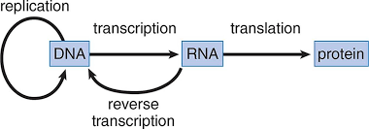
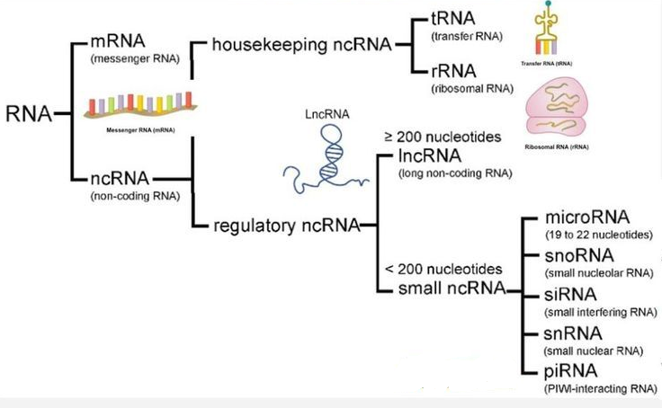
From DNA to RNA
Lecture - 14

Slide 2
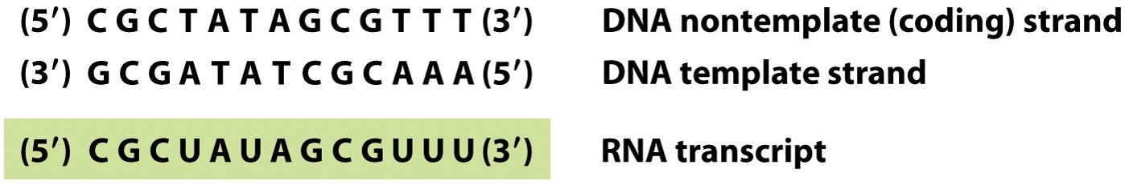

Slide 3
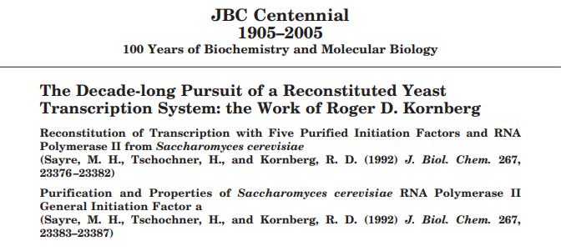
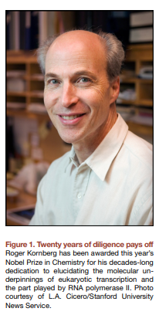
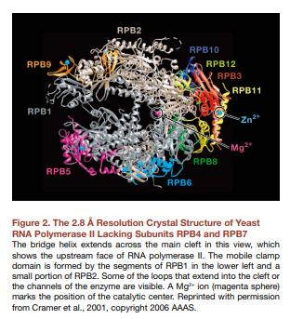
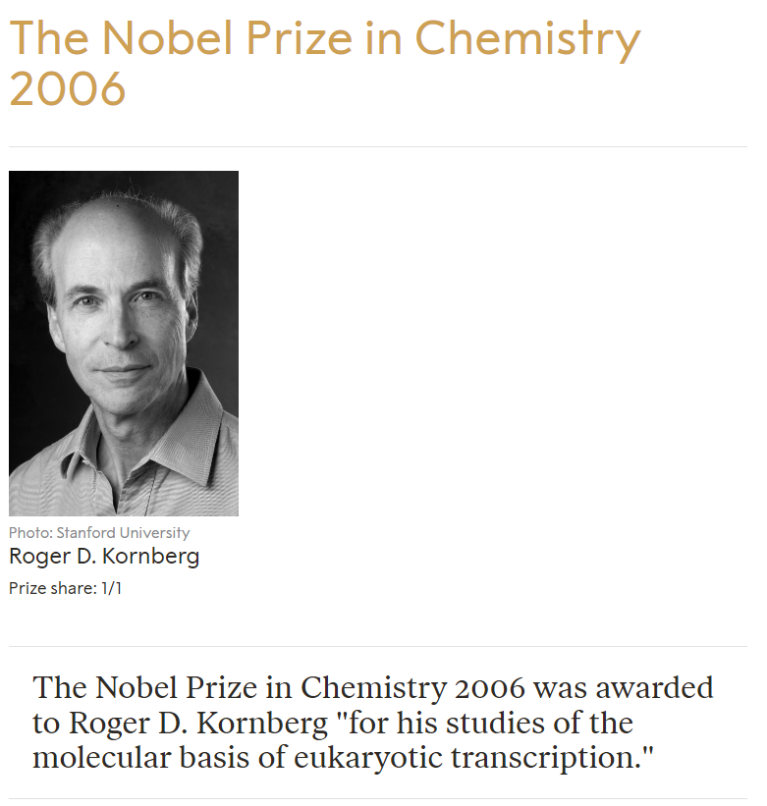


Slide 4
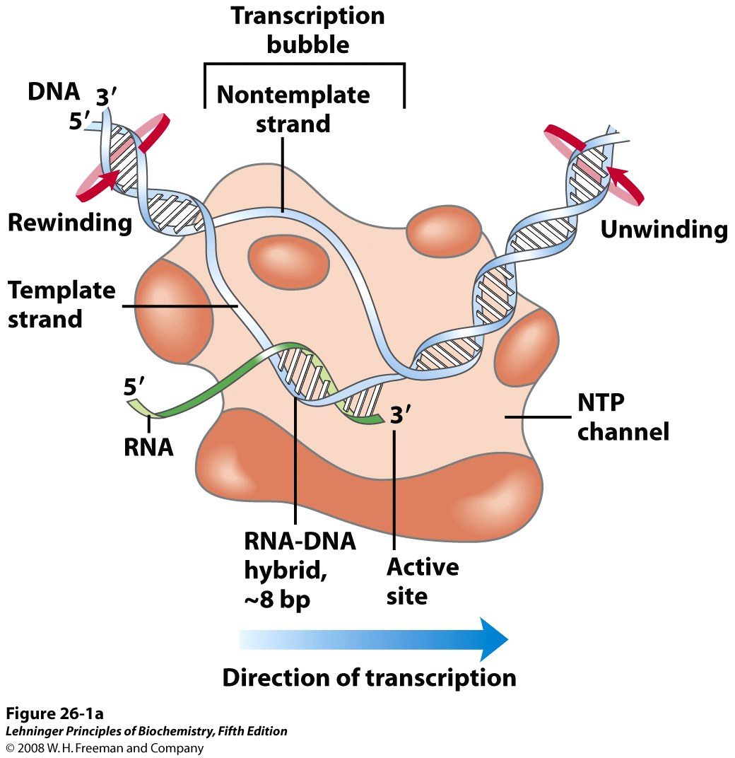
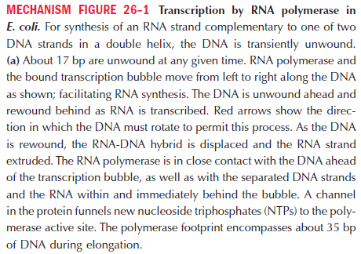

Slide 5
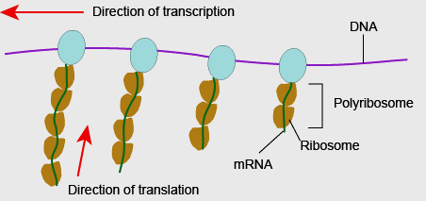
Fundamental difference between transcription and replication
RNA polymerase does not need a primer, rather it can initiate transcription de novo.
The RNA product does not remain base-paired to the template DNA strand (RNA-DNA hybrid is only ~ 8bp)
The RNA pol displaces the growing chain only a few nucleotides behind the site of polymerization.
This displacement is critical for the RNA to perform its functions (e.g., to be translated to produce its protein product). Furthermore, because this release follows so closely behind the site of polymerization, multiple RNA polymerase molecules can transcribe the same gene at the same time, each following closely behind another.
Thus, a cell can synthesize large numbers of transcripts from a single gene (or other DNA sequence) in a short time.

Slide 6
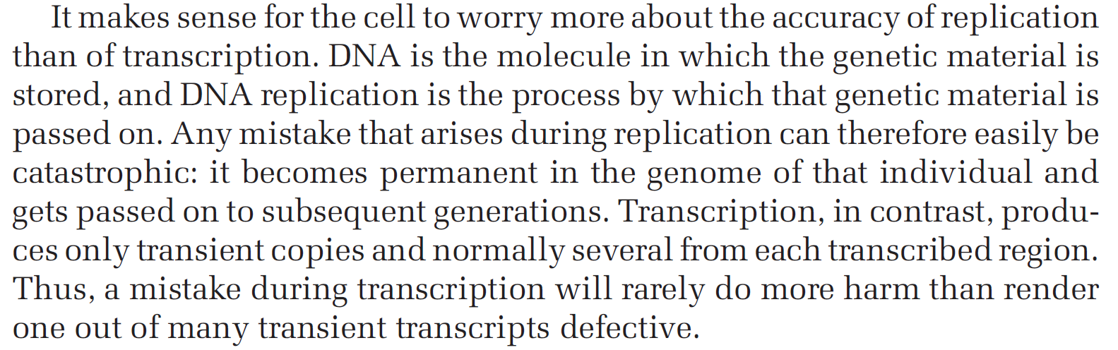
Accuracy of transcription
Transcription, although very accurate, is less accurate than replication (one mistake occurs in 10,000 nucleotides added, compared with one in 10 million for replication).
This difference reflects the lack of extensive proofreading mechanisms for transcription

Slide 7
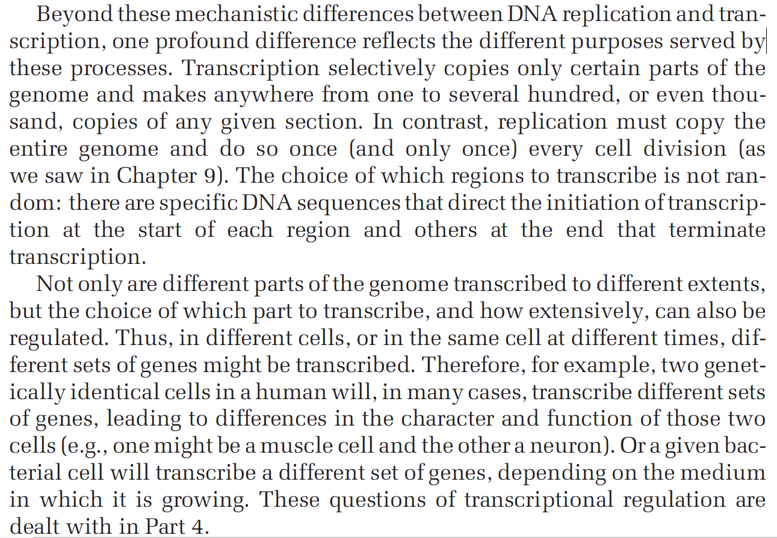

Slide 8
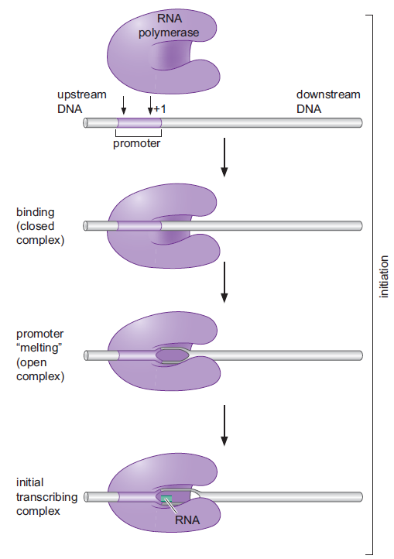
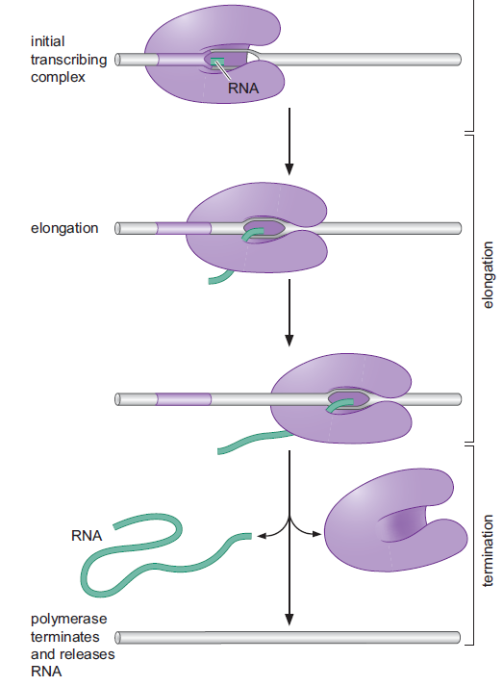
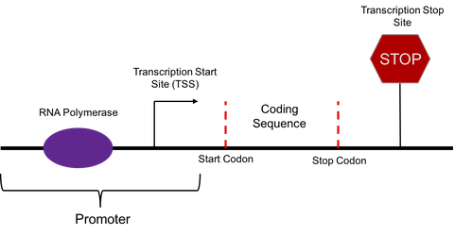

Slide 9
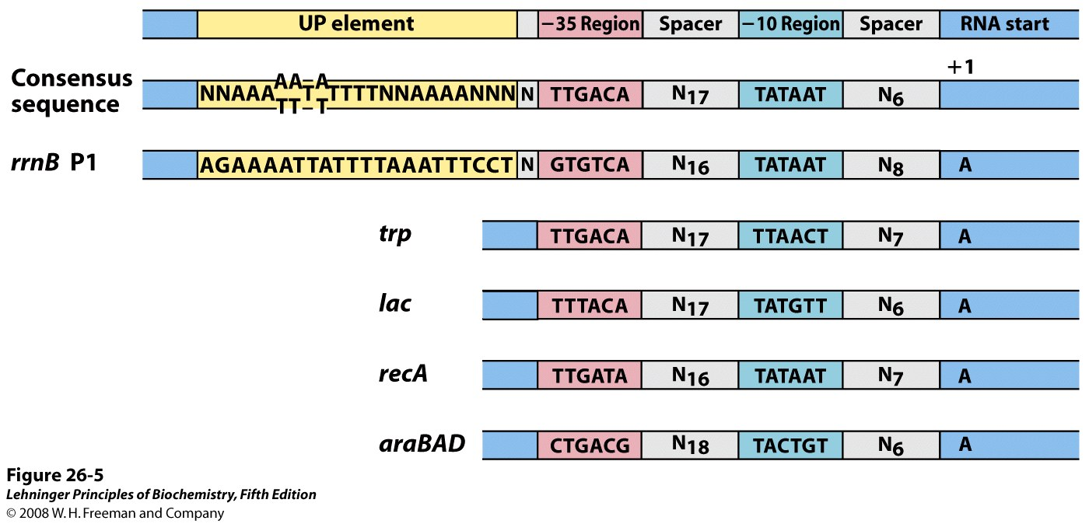
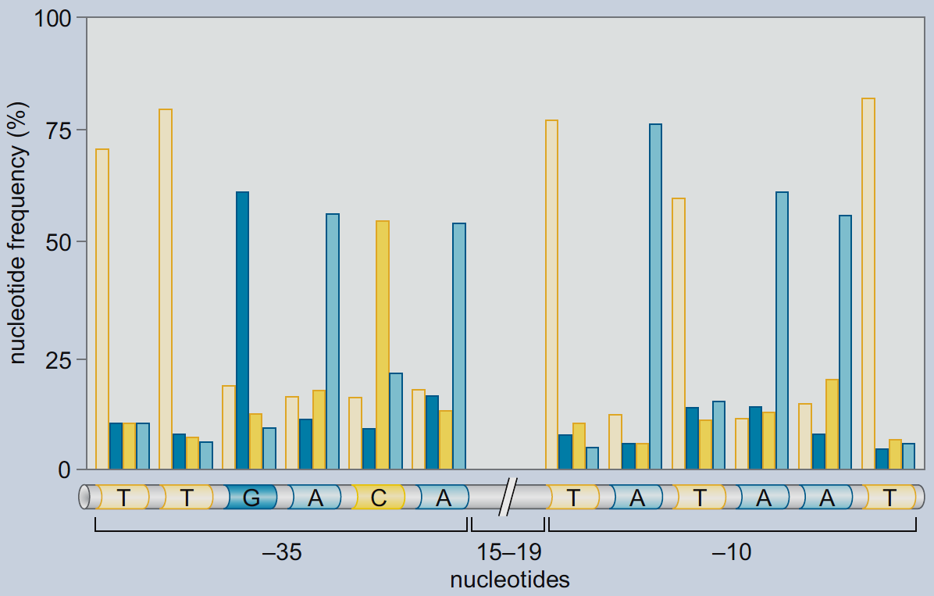
Initiation of transcription at the promoter
Notes:
Sequences of the nontemplate
strand are shown, read in the 5n3 direction, as is the convention
for representations of this kind. The sequences vary from one promoter
to the next, but comparisons of many promoters reveal similarities,
particularly in the 10 and 35 regions.

Slide 10
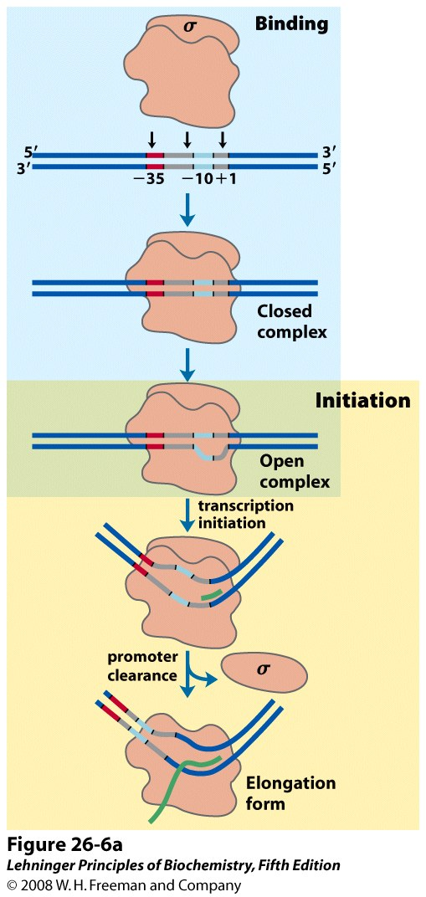
Mechanism of transcription initiation and elongation

Slide 11
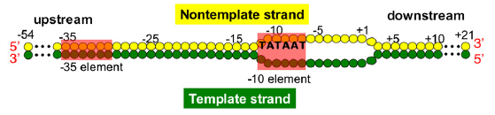
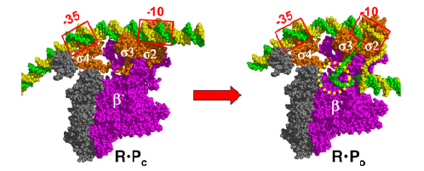
Promoter melting by RNA polymerase
Sigma factors are subunits of all bacterial RNA polymerases. They are responsible for determining the specificity of promoter DNA binding and control how efficiently transcription is initiated.
Notes:
Sigma factors are subunits of all bacterial RNA polymerases. They are responsible for determining the specificity of promoter DNA binding and control how efficiently RNA synthesis (transcription) is initiated. The first sigma factor discovered was the sigma70 (σ⁷⁰) of the highly studied bacterium Escherichia coli. Its discovery in 1968 was an

